Slide 1

Controlling a Swarm of Robots in a Simulator Stage using Reynolds Rules
Project - Simulation Phase
Multi-Robot Systems
Joseph Adeola
Khawaja Ghulam Alamdar
Moses Ebere
Nada Elsayed Abbas

Slide 2

Introduction: Reynold's Rules
Inspired by the natural coordination observed in flocks, schools, and herds in the animals
A rule-based approach where individual robots (boids) adhere to simple rules
These simple rules result in a collective group behavior
Emergence of 'order from chaos'

Slide 3
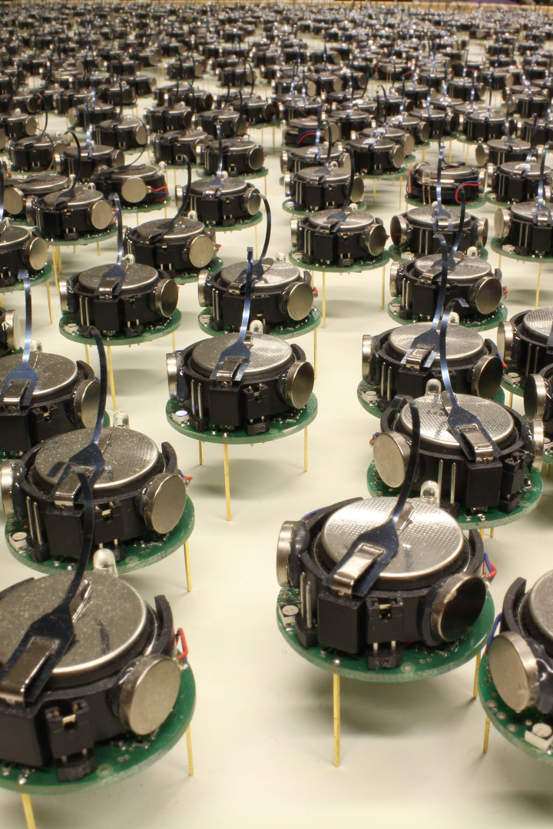
Basic Behaviors

Slide 4
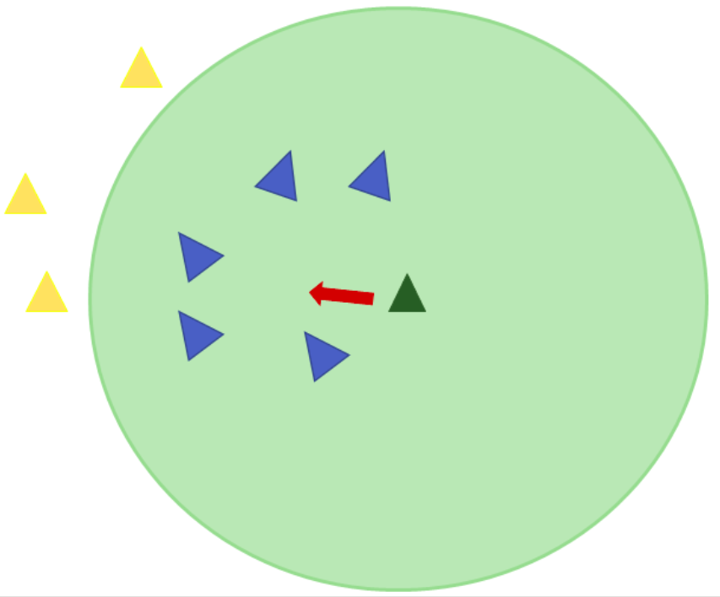
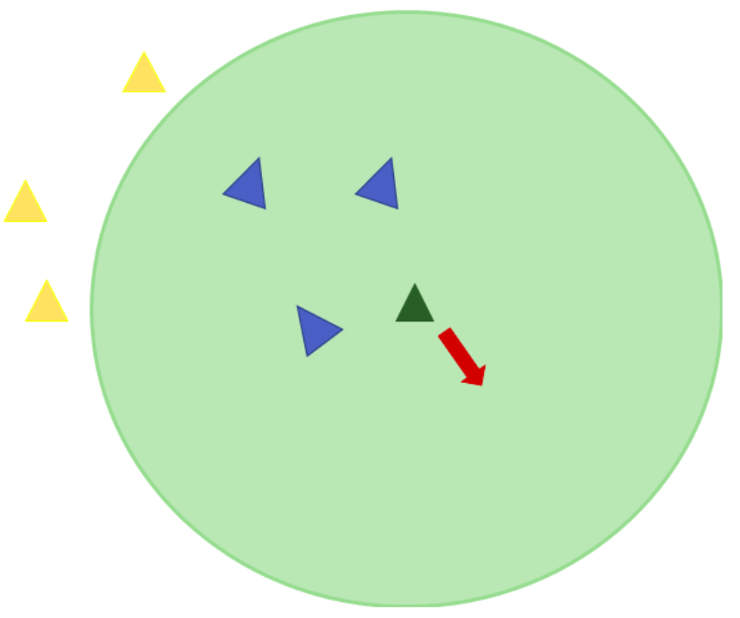
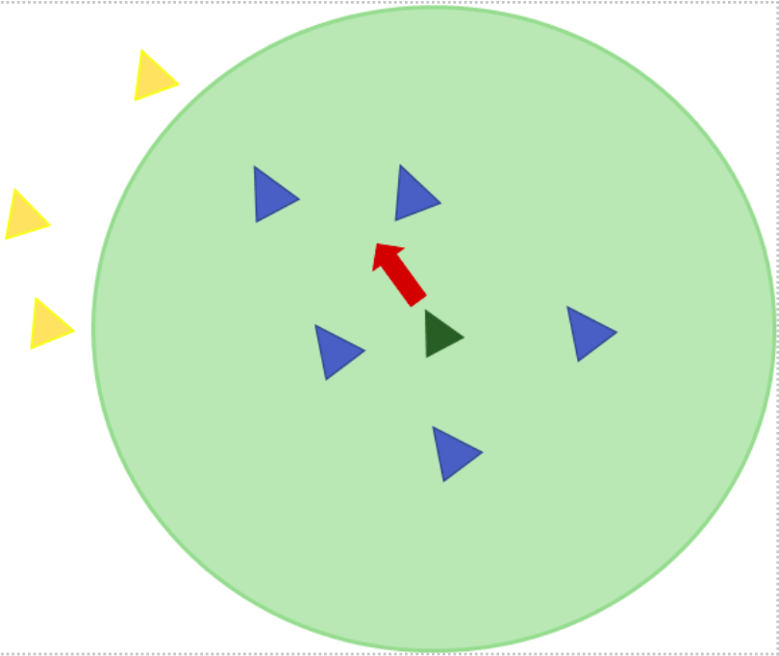
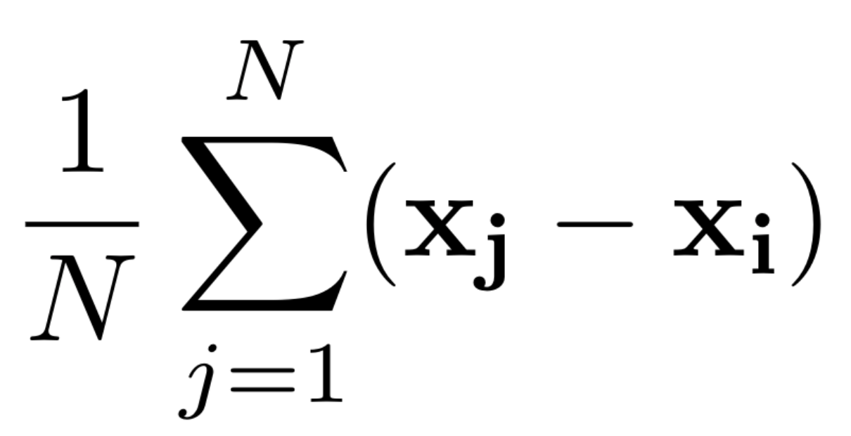
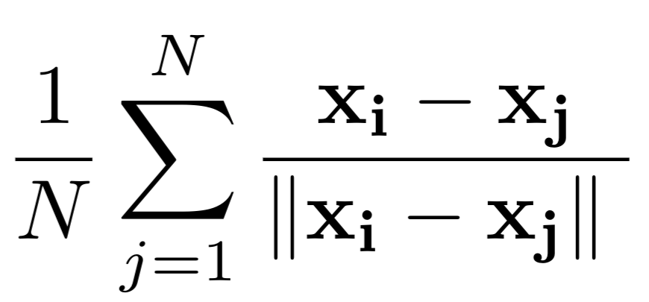
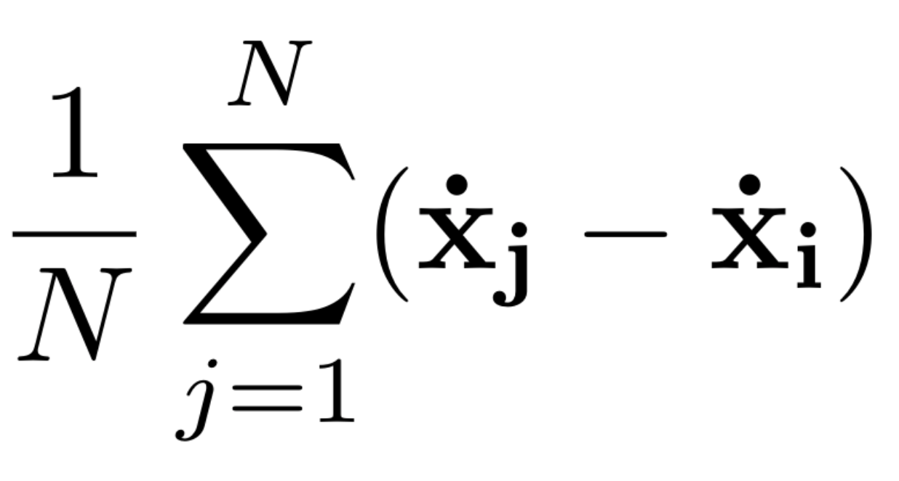
Reynolds Three Rules
Cohesion
Separation
Alignment

Slide 5
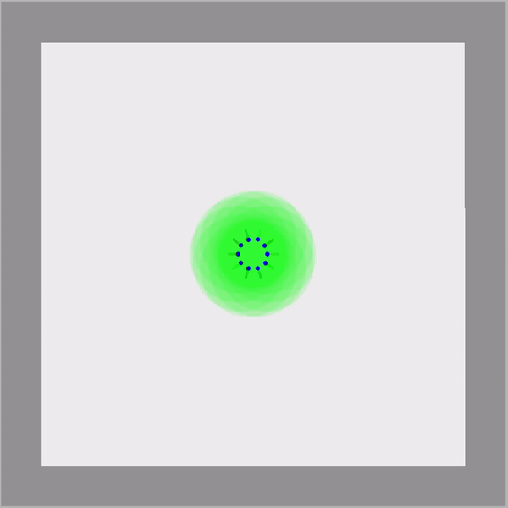
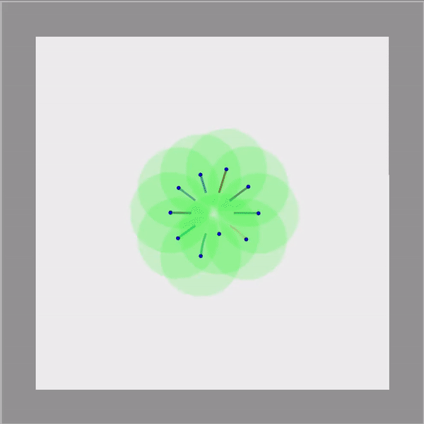
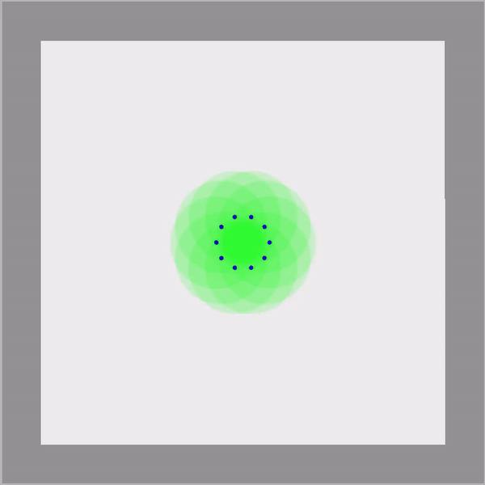
Reynolds Three Rules
Cohesion
Separation
Alignment

Slide 6

Local Neighborhood

Slide 7
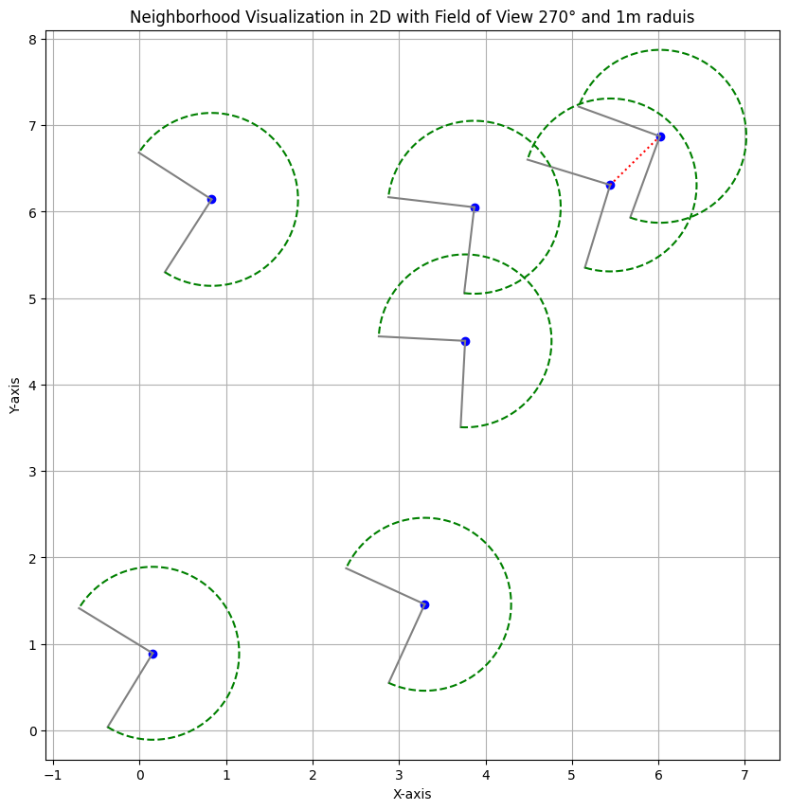
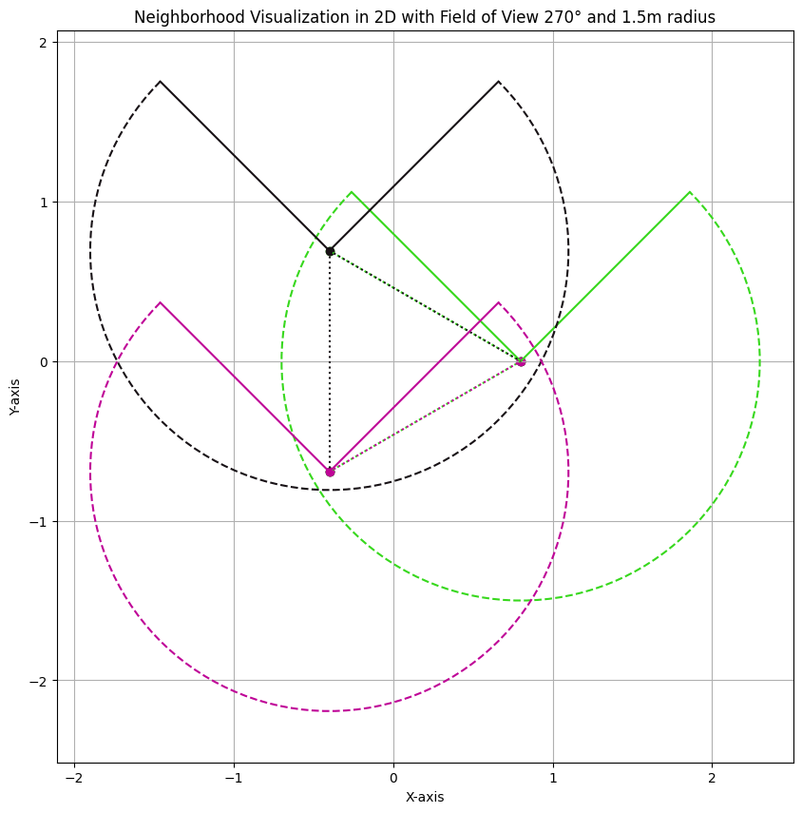
Local Neighborhood

Slide 8
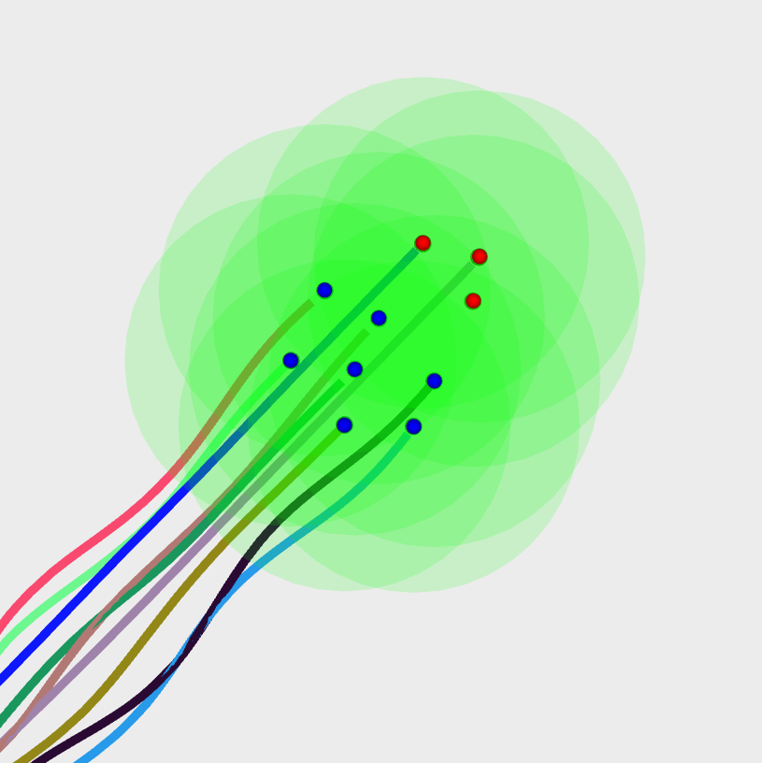
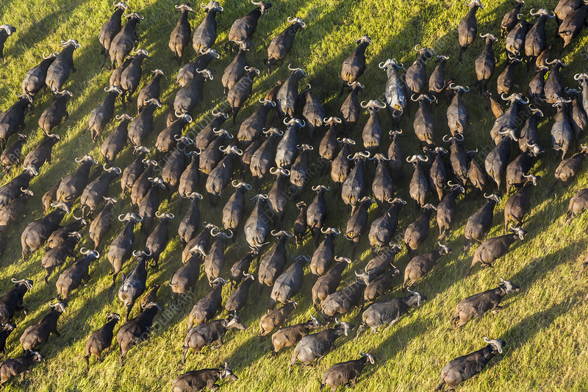
Effect of Local Neighborhood (FoV)
A large FoV results in circular/elliptical clusters like buffaloes.
A reduced FoV produces a streamlined flocking pattern, like bird movements
360 degrees.° FoV
300 to 360 degrees.° FoV

Slide 9
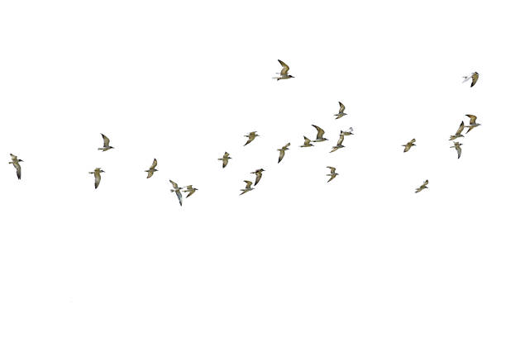
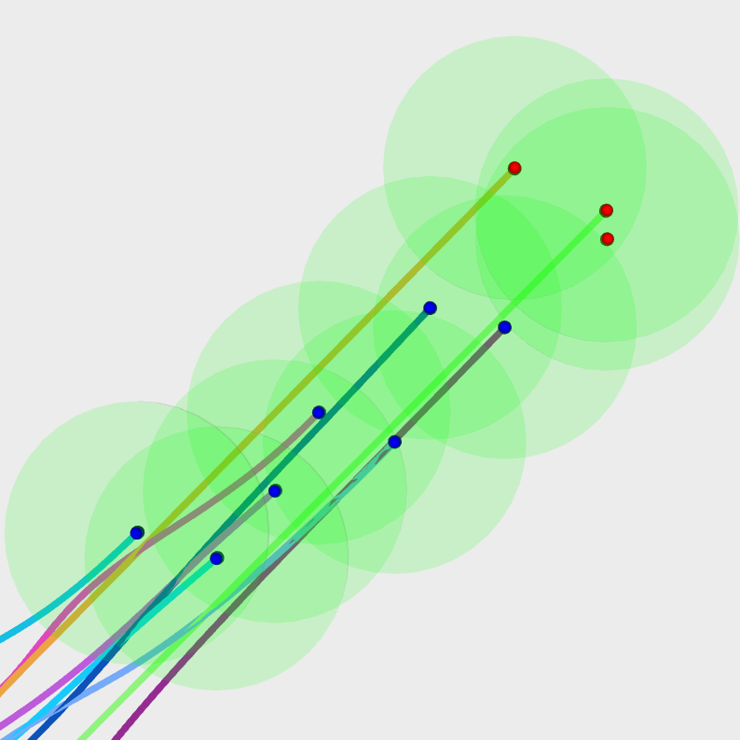
Effect of Local Neighborhood (FoV)
A large FoV results in circular/elliptical clusters
A reduced FoV produces a streamlined flocking pattern, like bird movements
270 ° FoV
135° FoV

Slide 10

Obstacle Avoidance

Slide 11
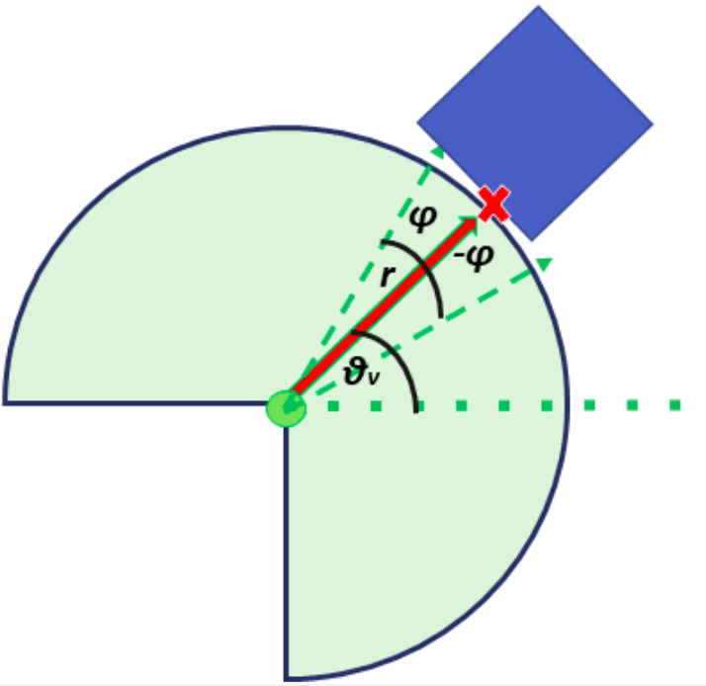
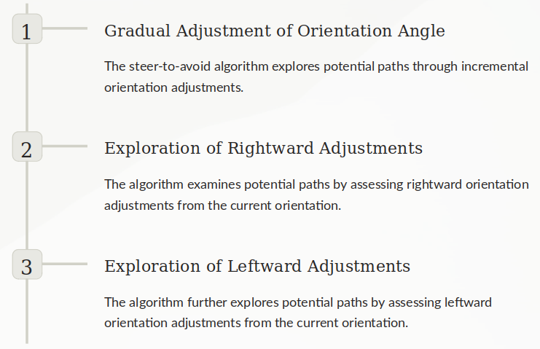
Obstacle Avoidance: Steer-To-Avoid

Slide 12
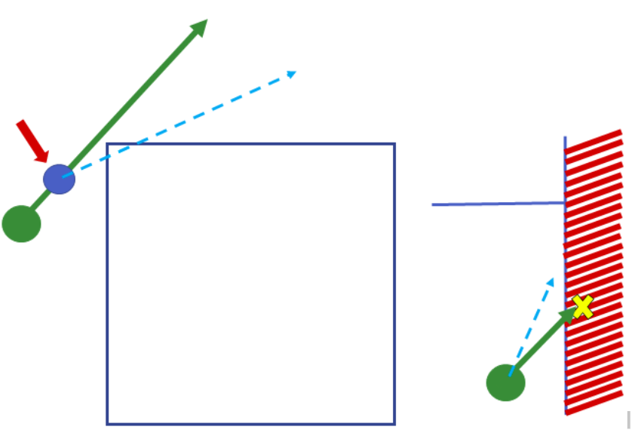
Obstacle Avoidance: Steer-To-Avoid
Check path validity
Corner cases

Slide 13
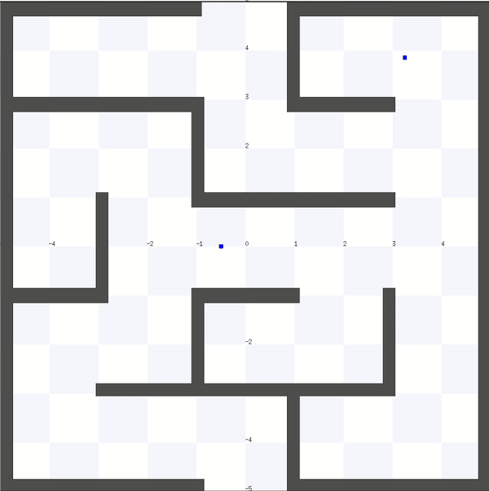
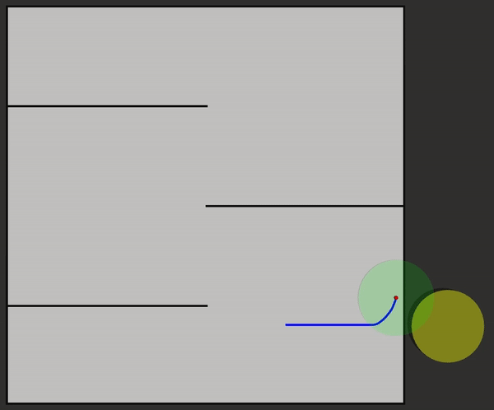
Obstacle Avoidance: Comparison
Steer to avoid even works in corner cases

Slide 14
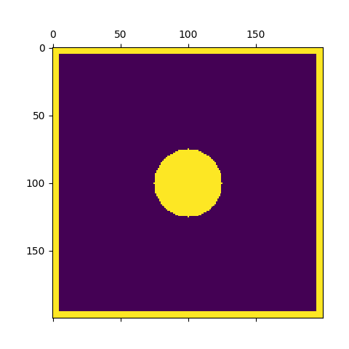
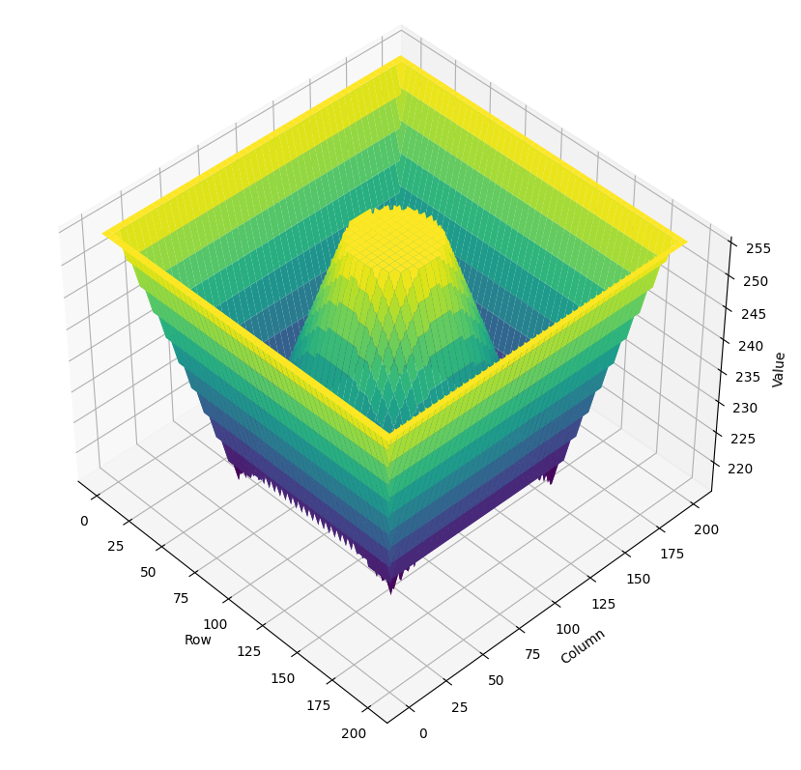
Obstacle Avoidance: Potential Field
Potential Field around the obstacle created using brushfire/wavefront
Value of the potential function encodes the distance from the obstacles
Goal: To go 'downhill' i.e., away from the obstacle

Slide 15
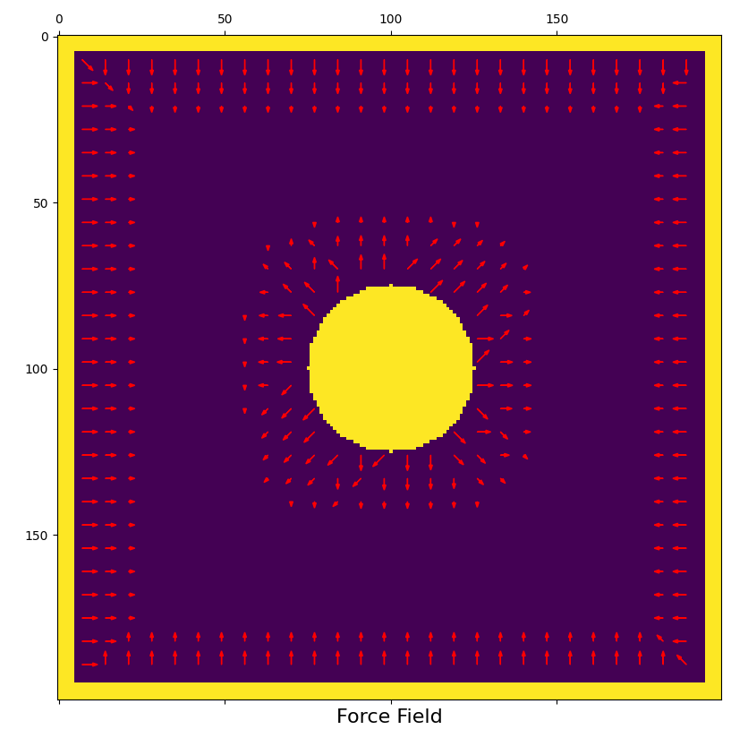
Obstacle Avoidance: Potential Field
Gradient of the potential function gives this downhill direction
This 'Force Field' is scaled with proximity to obstacle and normalized
The field only affects the area near the obstacles

Slide 16
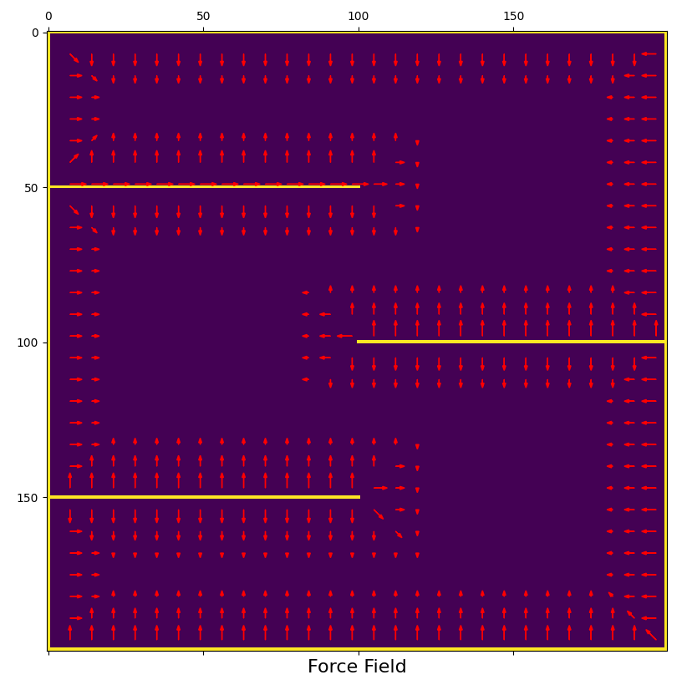
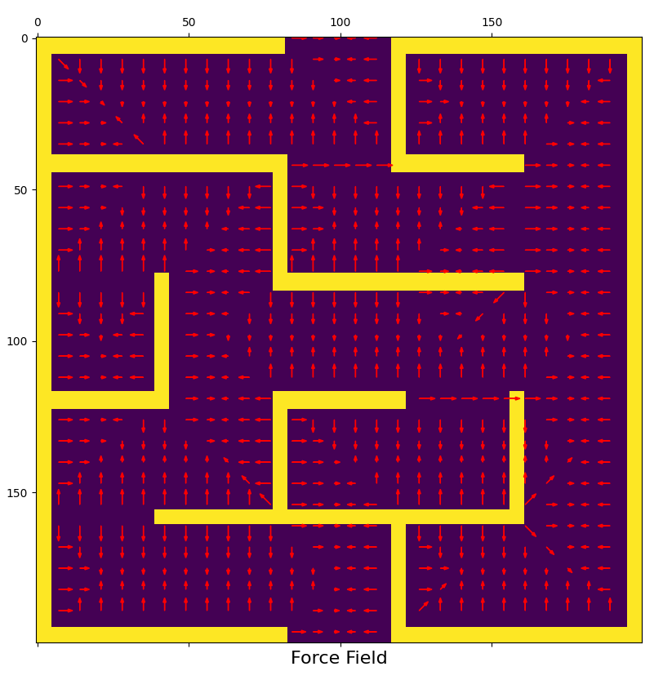
Obstacle Avoidance: Potential Field
Examples

Slide 17
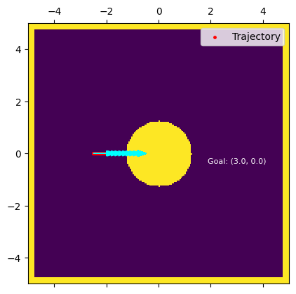
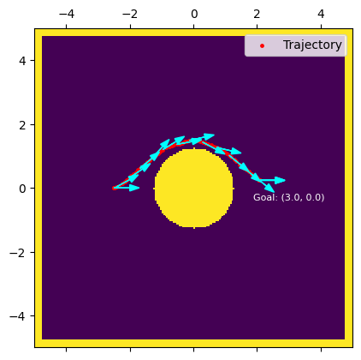
Obstacle Avoidance: Comparison
Potential field
Pros | Computationally fast (Global planning) Retrieving the force vector from the Boid's current cell
Cons | Boids can get stuck in local minima Can lead to oscillatory behavior
Potential Field
Steer-to-Avoid

Slide 18
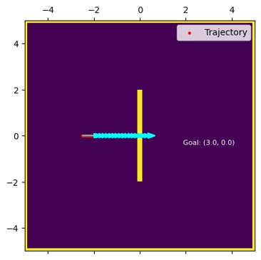
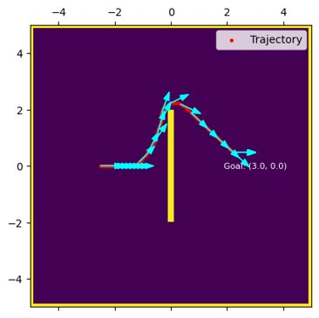
Obstacle Avoidance: Comparison
Steer to avoid
Pros | Real-time Responsiveness (Local Planning) Adaptable to Dynamic Environments(Agile Navigation)
Cons | Can struggle in highly cluttered or complex
Potential Field
Steer-to-Avoid

Slide 19
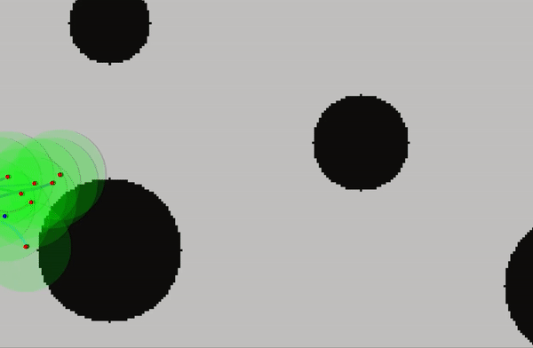
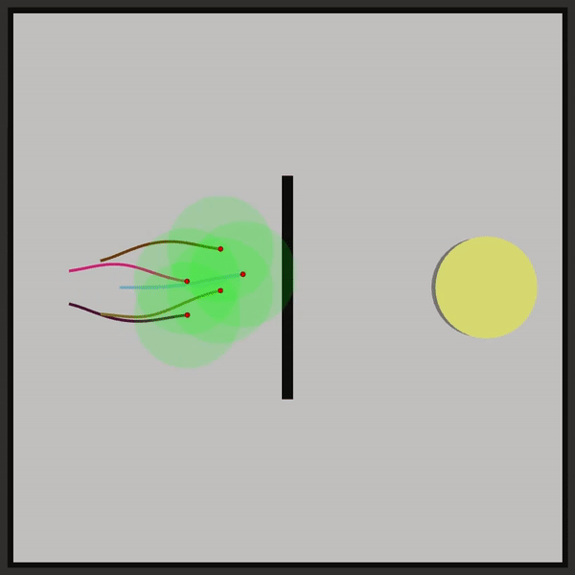
Effect of Increment Angle of Steer-to-avoid
Environments with lengthy wall obstacles benefit from a slightly higher increment angle.
In cluttered settings, especially with smoother obstacles, a smaller increment angle allows for more agile movements around obstacles

Slide 20

Arrival

Slide 21
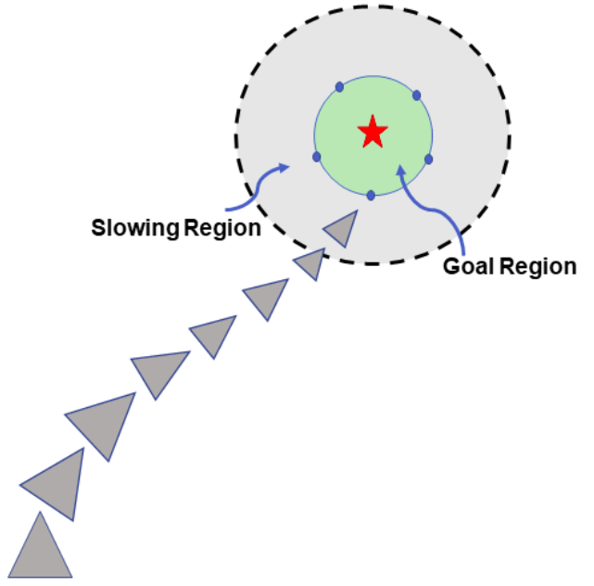
Arrival
Migrating flock to aggregate at a particular position in the map.
Slowing distance, Goal Tolerance, Tanh for convergence.
target_offset = target – position
distance = length(taget_offset)
ramped_speed = max_speed * (distance/slowing_distance)
clipped_speed = minimum (ramped_speed, max_speed)
steering = (clipped_speed/distance) * target_offset

Slide 22
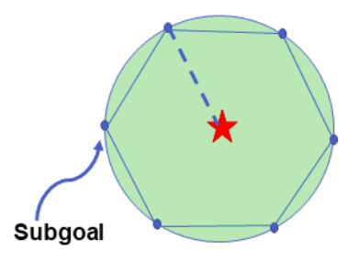
Arrival
Subgoal generation (equidistant points of minimum separation distance).
Subgoals for Leaders
Arrival Behavior

Slide 23
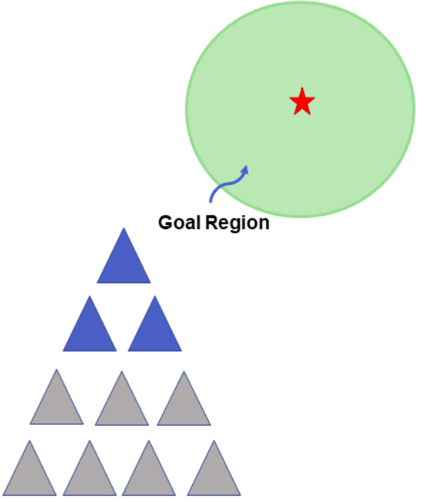
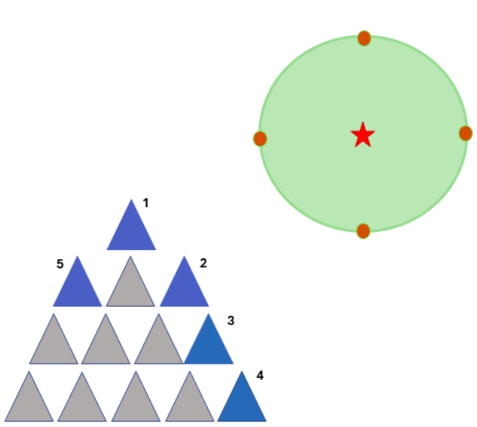
Arrival: Leader Selection
Assign the closest boid to each subgoal as a leader, irrespective of position.
Identify boundary boids then select those closest to each subgoal as a leader.
(a) Nearest Neighbor
(b) Convex Hull

Slide 24
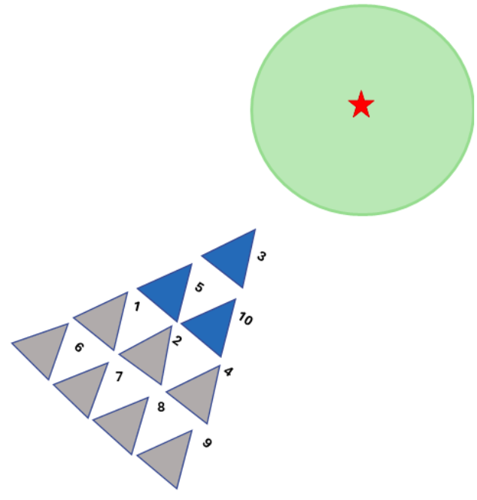
Arrival: Dynamic Leadership
Reassign leadership as formation changes during migration to goal.
Leading boids are those always closest to the goal.
Initial Leaders
New Leaders

Slide 25
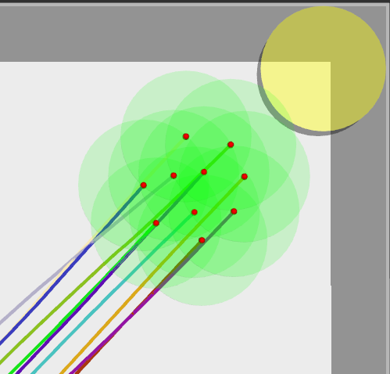
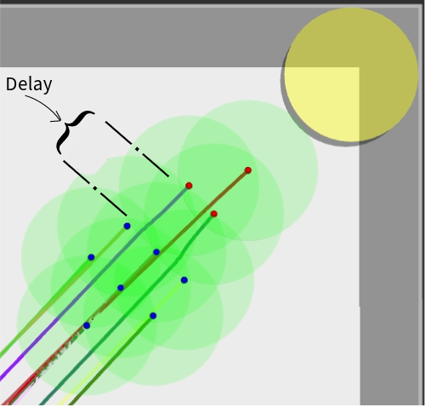
Effect of No. Of Leaders
When the migratory urge affects all boids in the flock, the reaction of all the boids is instant.
On the other hand, a flock of boids will act more naturally when the migratory urge is sensed by only a subset of the flock (i.e., a few "leaders")
Global Migratory Urge
Local Migratory Urge

Slide 26
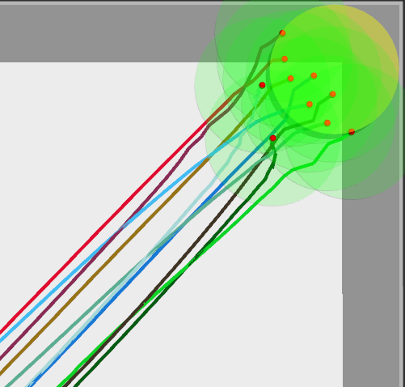
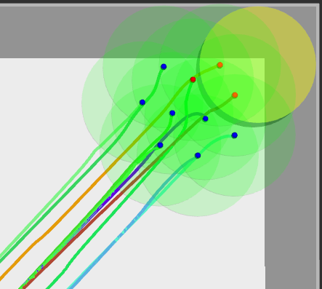
Effect of No. Of Leaders
Global and Local Migratory Urge Convergence
Global Migratory Urge
Local Migratory Urge

Slide 27

Prioritized Acceleration Allocation

Slide 28
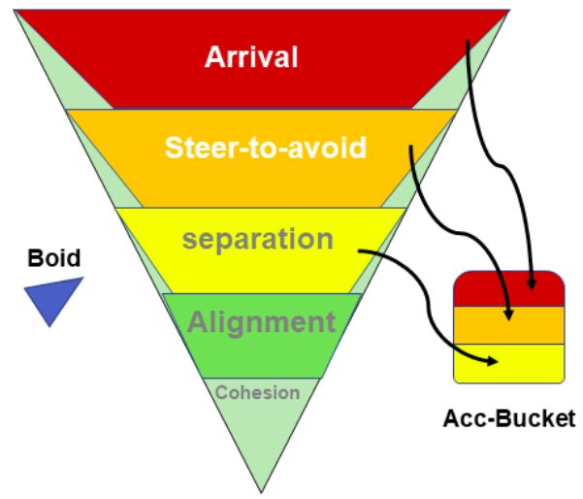
Prioritized Acceleration Allocation
In weighted average, conflicting forces may cancel out leading to undesirable responses.
 | Prioritized Acceleration
Pros | Assigns limited acceleration to most critical behaviors.
Cons | prioritization is context- and environment-specific in most cases.

Slide 29
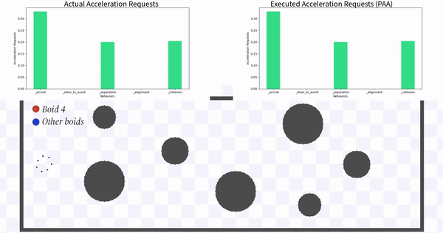
Prioritized Acceleration

Slide 30

Software Architecture

Slide 31
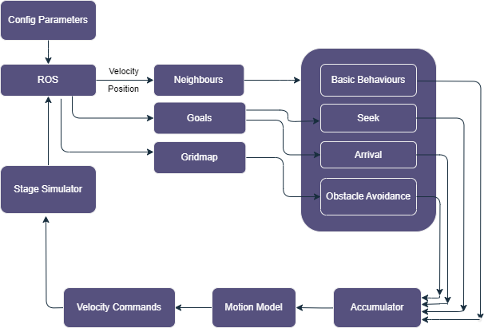
Software Architecture

Slide 32

Results

Slide 33
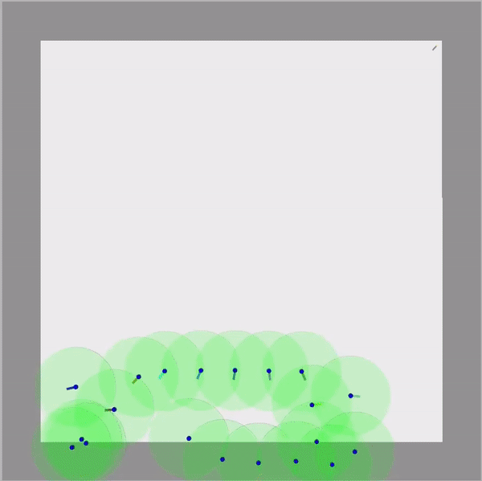
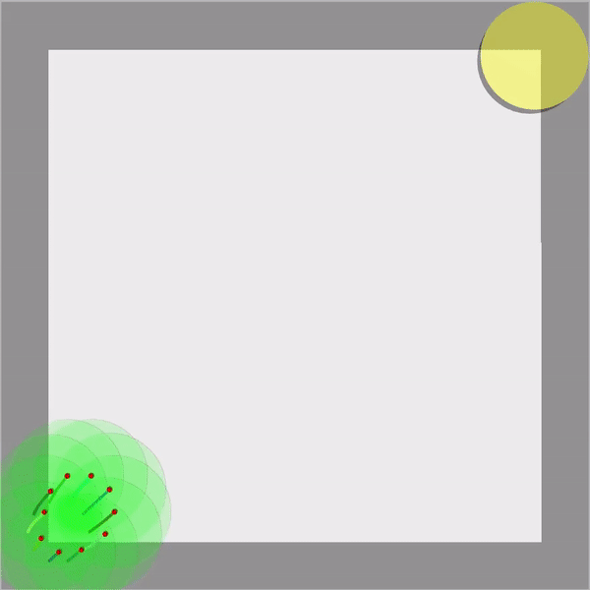
Simulation Results: Map A
Basic behaviors with steer-to-avoid, 20 boids.
Basic behaviors with migratory urge.

Slide 34
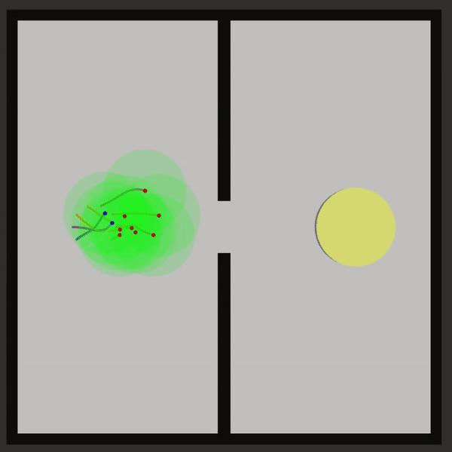

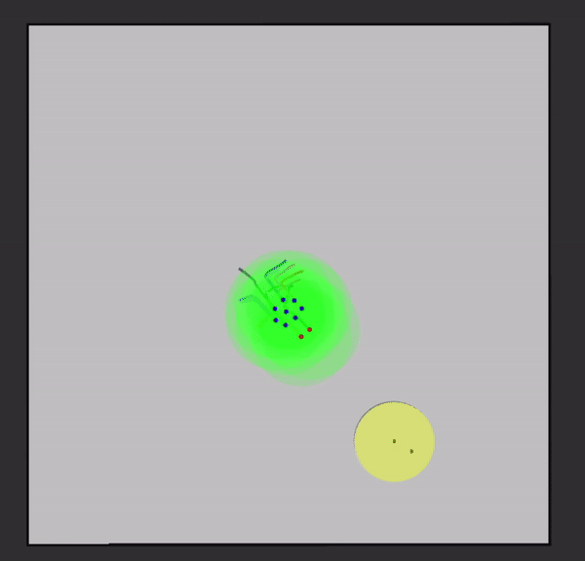
Simulation Results
Multi-goal aggregation
Navigating a slit with a small FoV

Slide 35
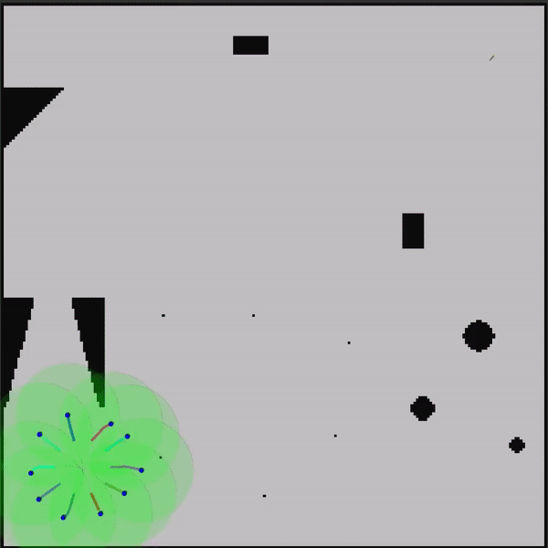
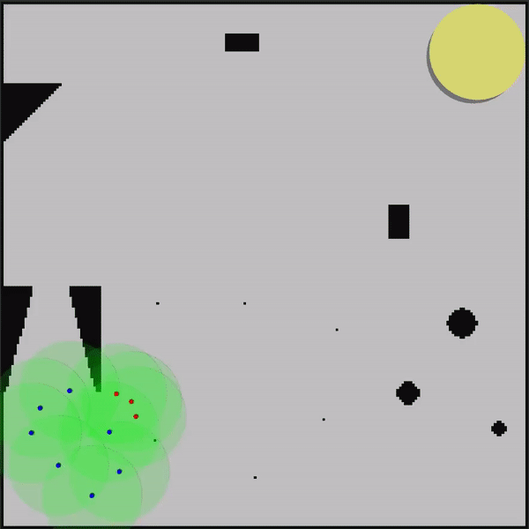
Simulation Results: Map B
Basic behaviors,OA & roaming
Basic behaviors, OA & migratory urge on some boids

Slide 36


Simulation Results: Map C
Basic behaviors, OA & roaming.
Basic behaviors, OA & migratory urge on some boids

Slide 37


Simulation Results: Map D
Basic behaviors, OA & migratory urge
See through wall corner-case

Slide 38


Nuno
Gracias

Slide 39


Simulation Results: Additional Map
Basic behaviors, obstacle avoidance and migratory urge

Slide 40
Future Work

Slide 41

Future Work
Inclusion of bug algorithm to enable the flock to solve mazes
Balances exploitation and exploration
Implementation on hardware – Crazyflies hehehehe

Slide 42
Appendix

Slide 43



Convex Hull
Convex Hull

Slide 44






Multi-Goal Aggregation

